Slide 1
SI 671/721
Lab 9
Deep Learning

Slide 2
Content
Deep Learning
Tensorflow keras:
https://www.tensorflow.org/tutorials
Word embedding model
Word2Vec
Glove
Named Entity Recognition
LSTM
Word embedding

Slide 3
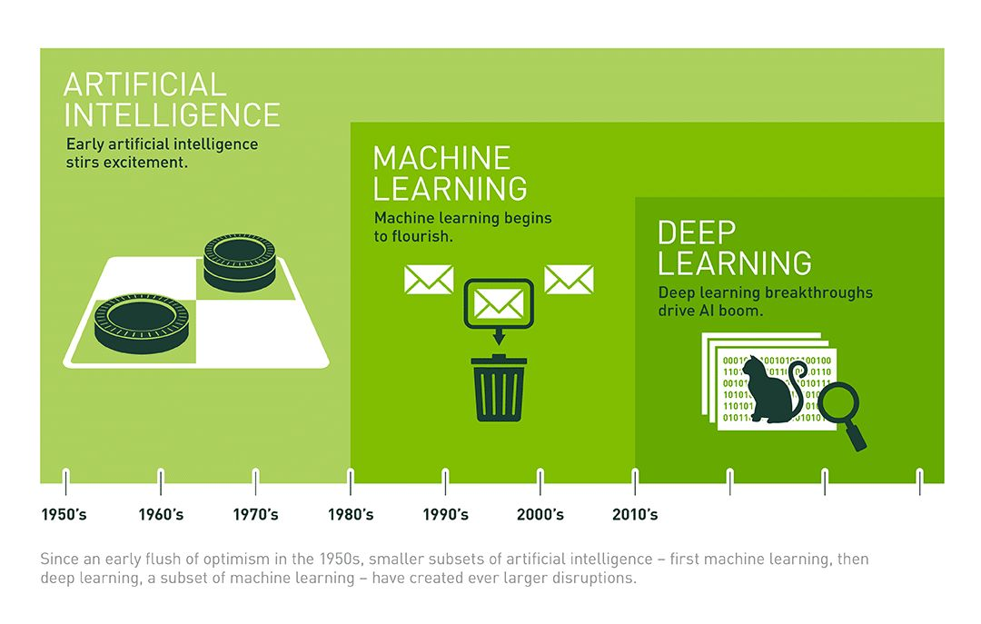
Deep Learning

Slide 4
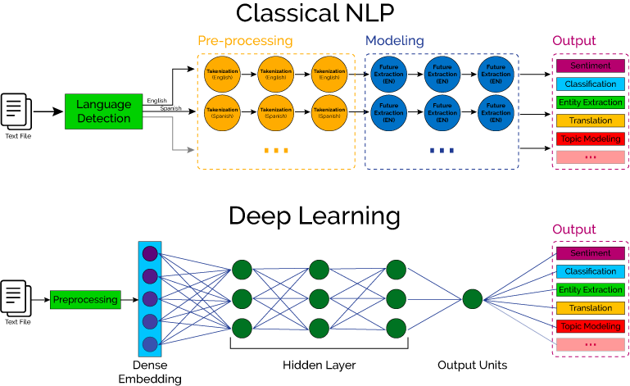

Slide 5

Keras
TensorFlow, PyTorch, MXNet, …
Keras: high-level API of TensorFlow.
https://keras.io/api/layers/

Slide 6
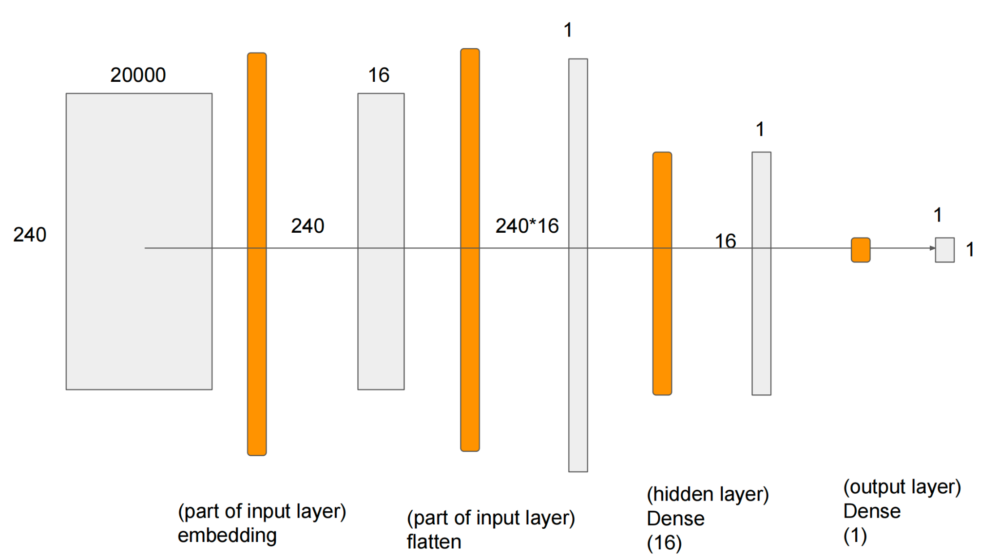
Word Embedding

Slide 7
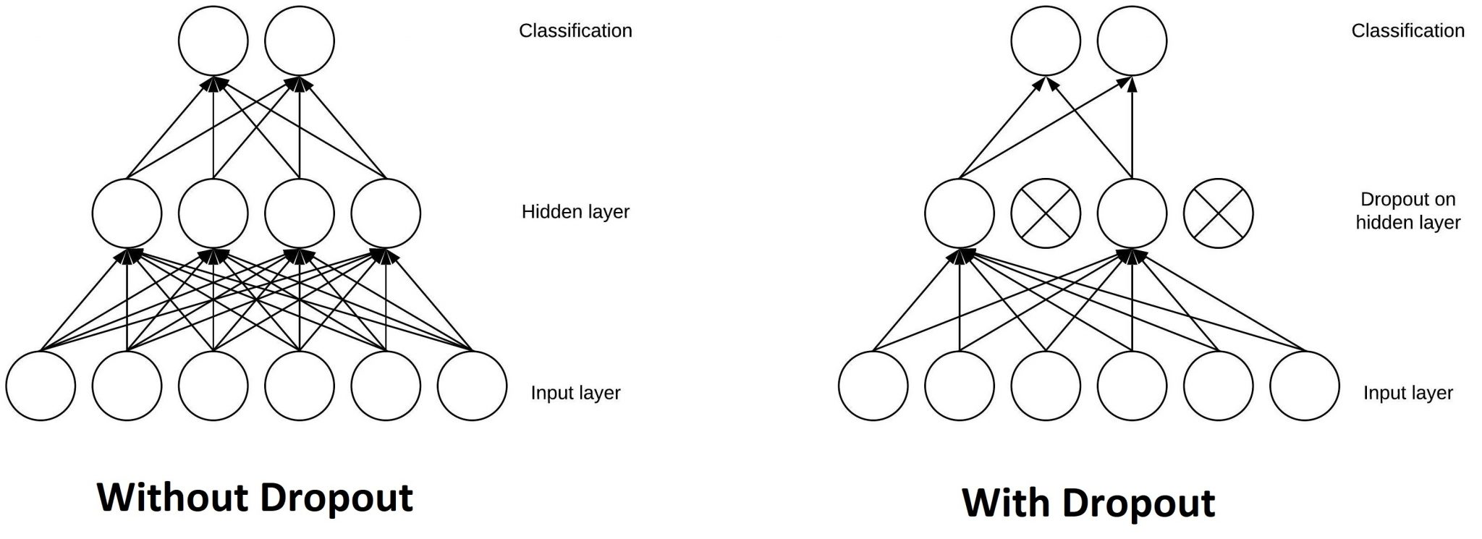
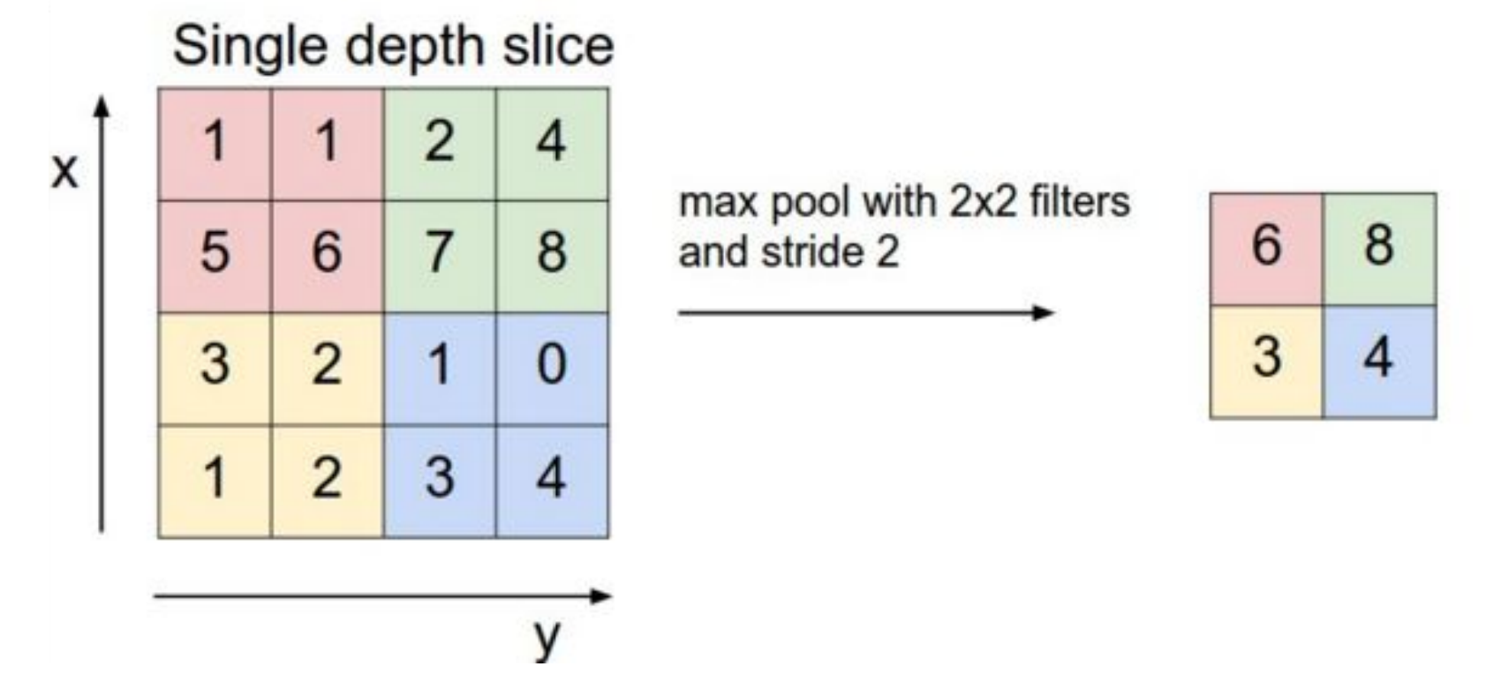
Dropout & Pooling
Dropout:
Randomly deactivates a fraction of neurons (units) in a layer in training.
Prevent overfitting in neural networks, avoid co-adaption, and improve model generalization.
Pooling:
Reduce spatial dimensions of feature maps and help maintain translation invariance.
Improve model efficiency and prevent overfitting.

Slide 8
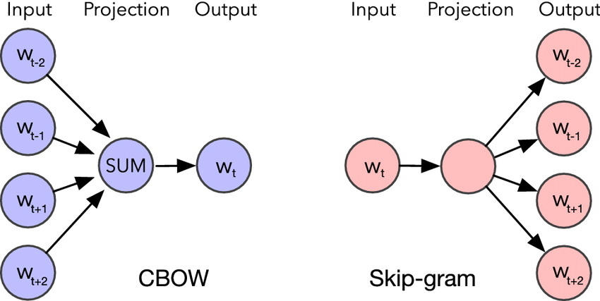
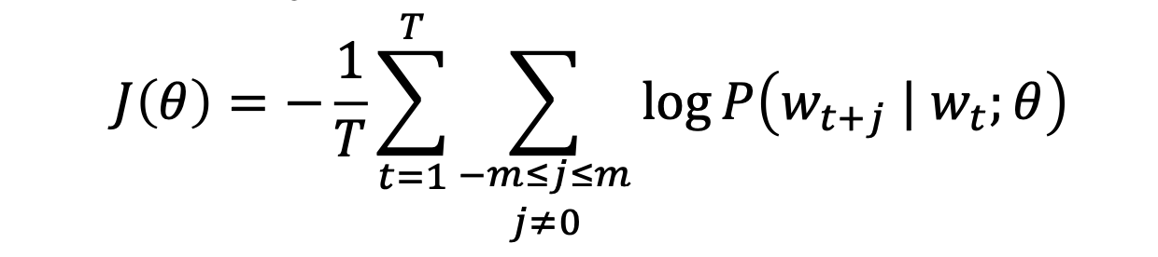
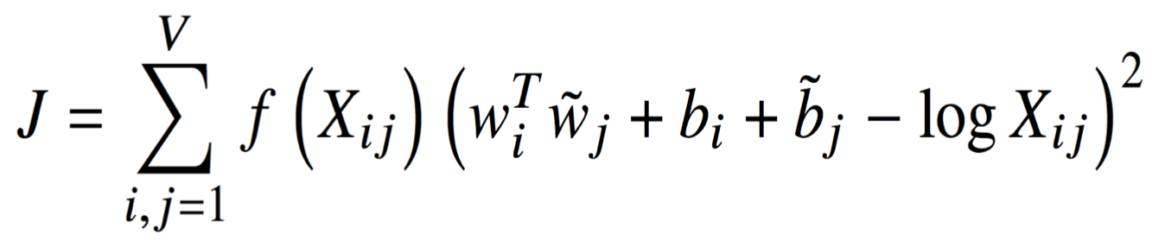
Word2Vec & GloVe
Word2vec
Skip-grams (Negative sampling)
CBOW (Huffman tree)
Predictive: co-occurrence
GloVe
Count: word-word co-occurrence probabilities have the potential for encoding some form of meaning.
https://nlp.stanford.edu/pubs/glove.pdf
Notes:
Globe vector for word representation
Refer to https://stackoverflow.com/questions/56071689/whats-the-major-difference-between-glove-and-word2vec

Slide 9
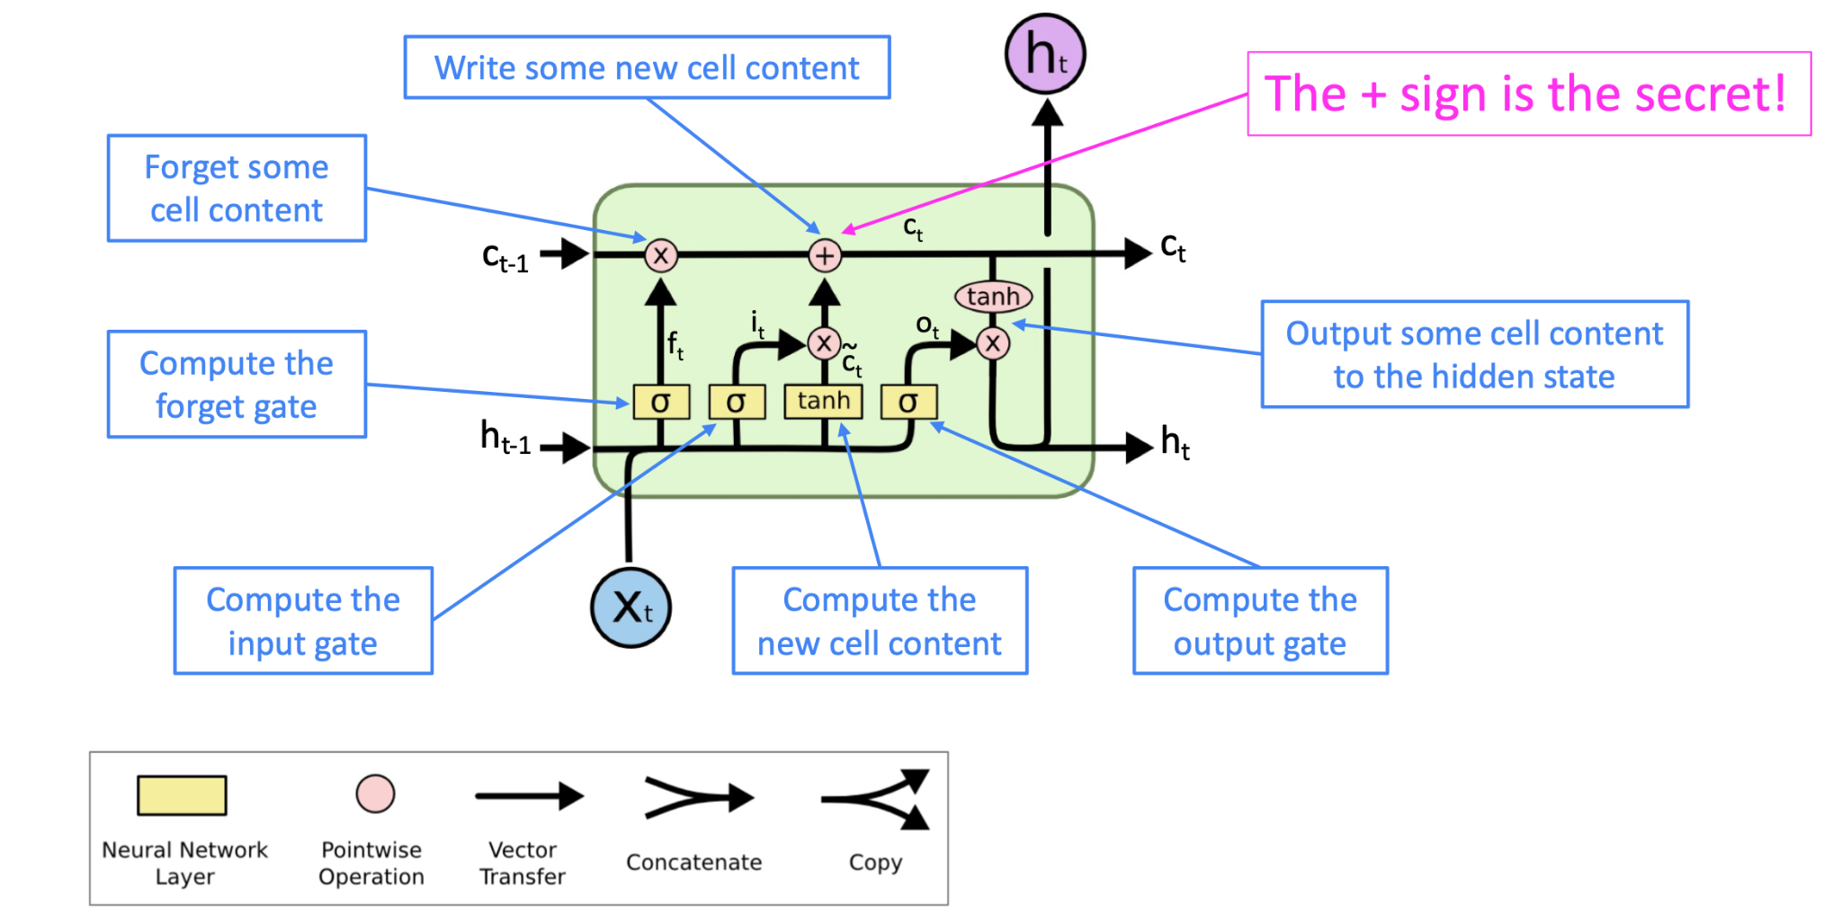
LSTM (Long Short Term Memory)
Improved RNN: capture important term in a ‘long distance’
“I grew up in France... I speak fluent ____”
Notes:
http://colah.github.io/posts/2015-08-Understanding-LSTMs/
Use the past context as hidden layer
BiLSTM in lab

